Slide 1
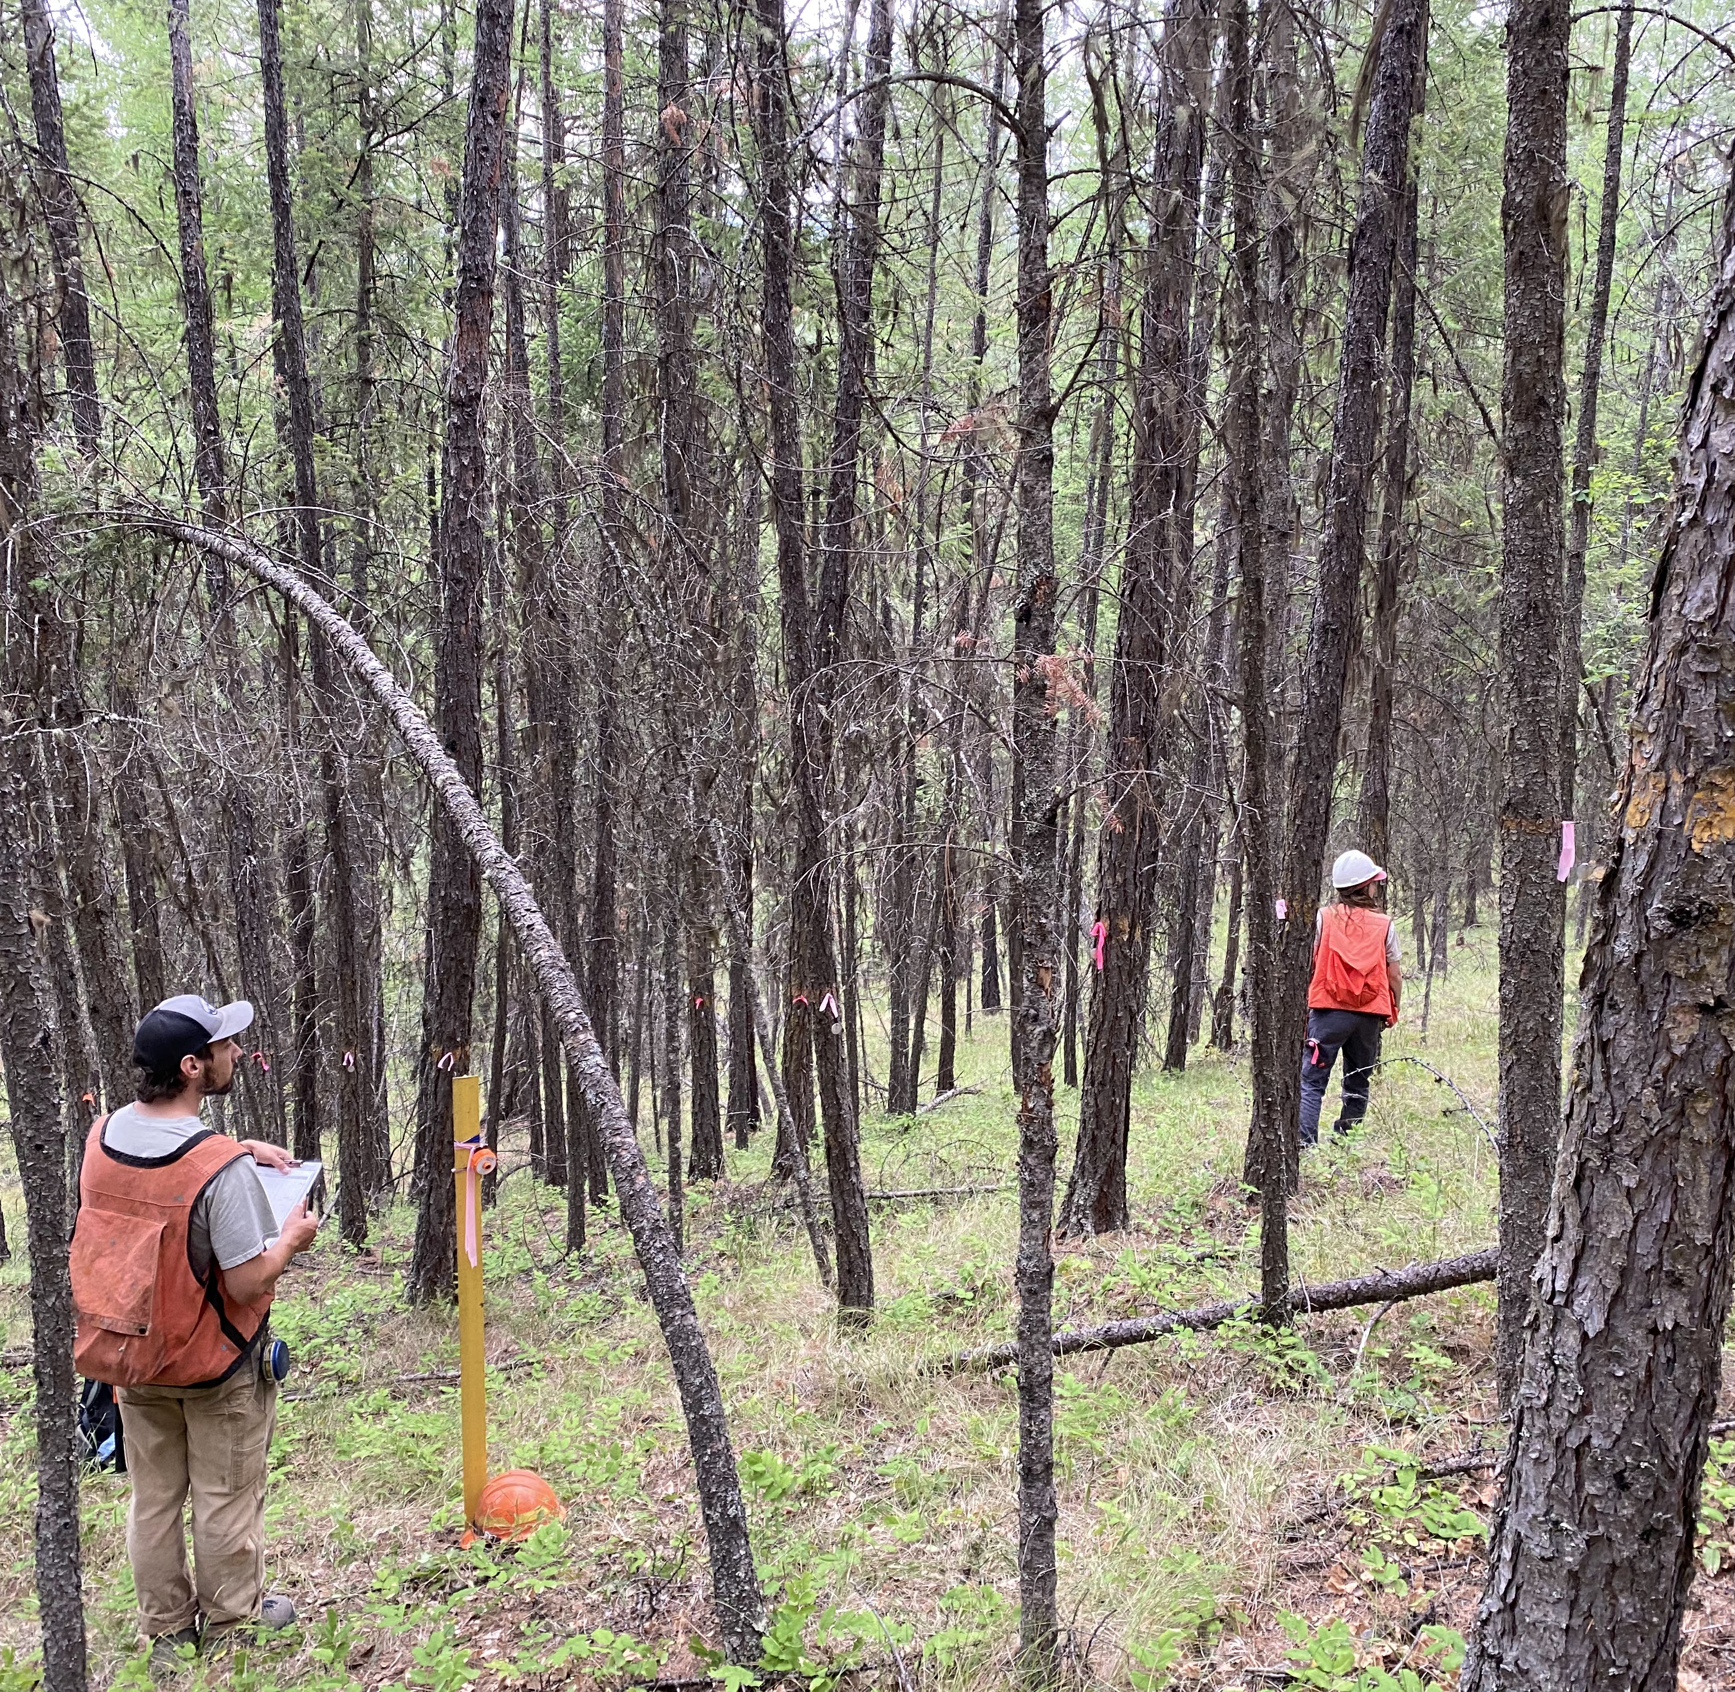
Permanent Growth Plot (PGP) Data
Christian Mercado
MS Student, Forestry
Notes:
Introduction:

Slide 2
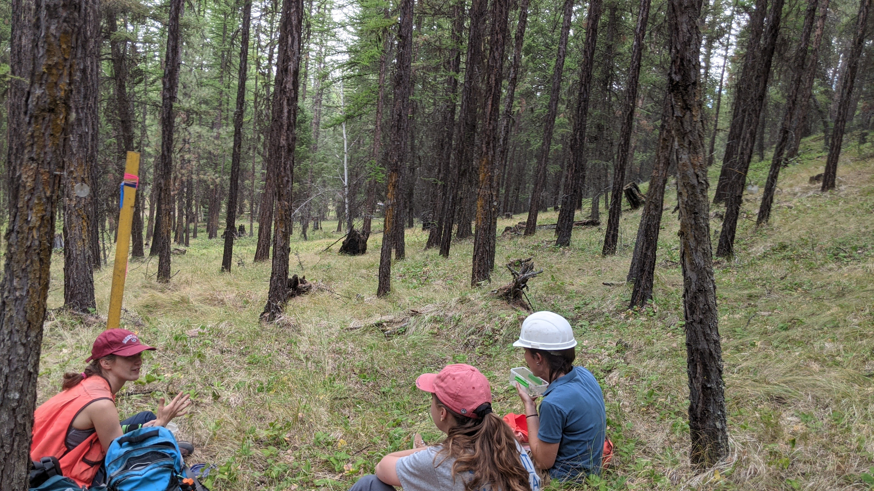
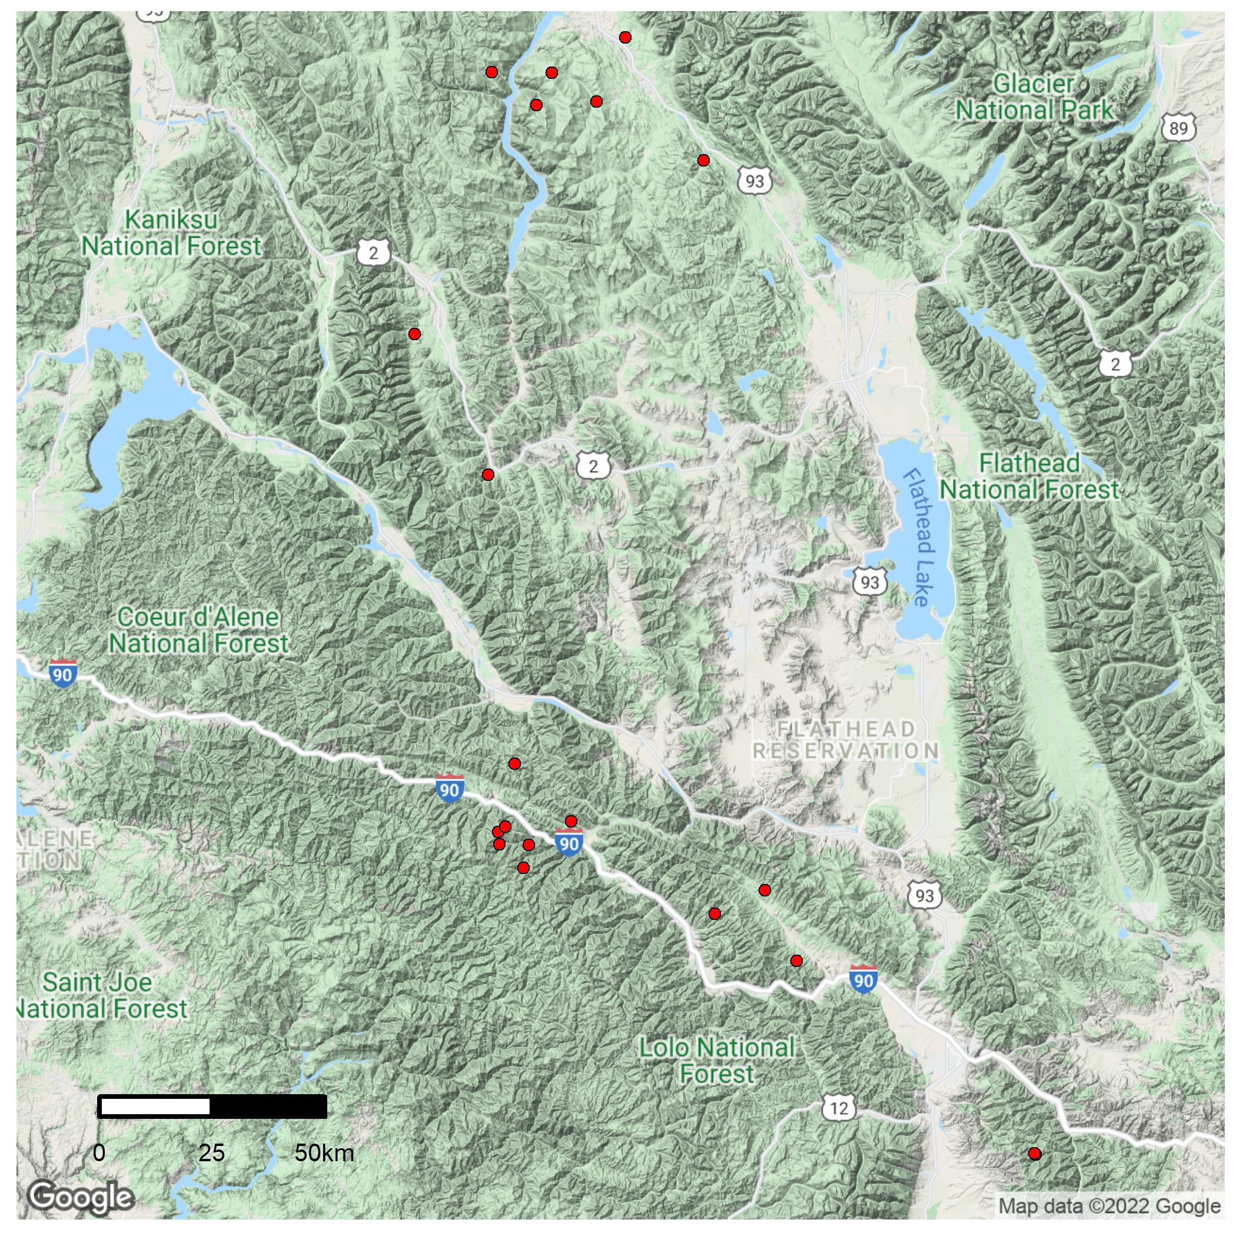
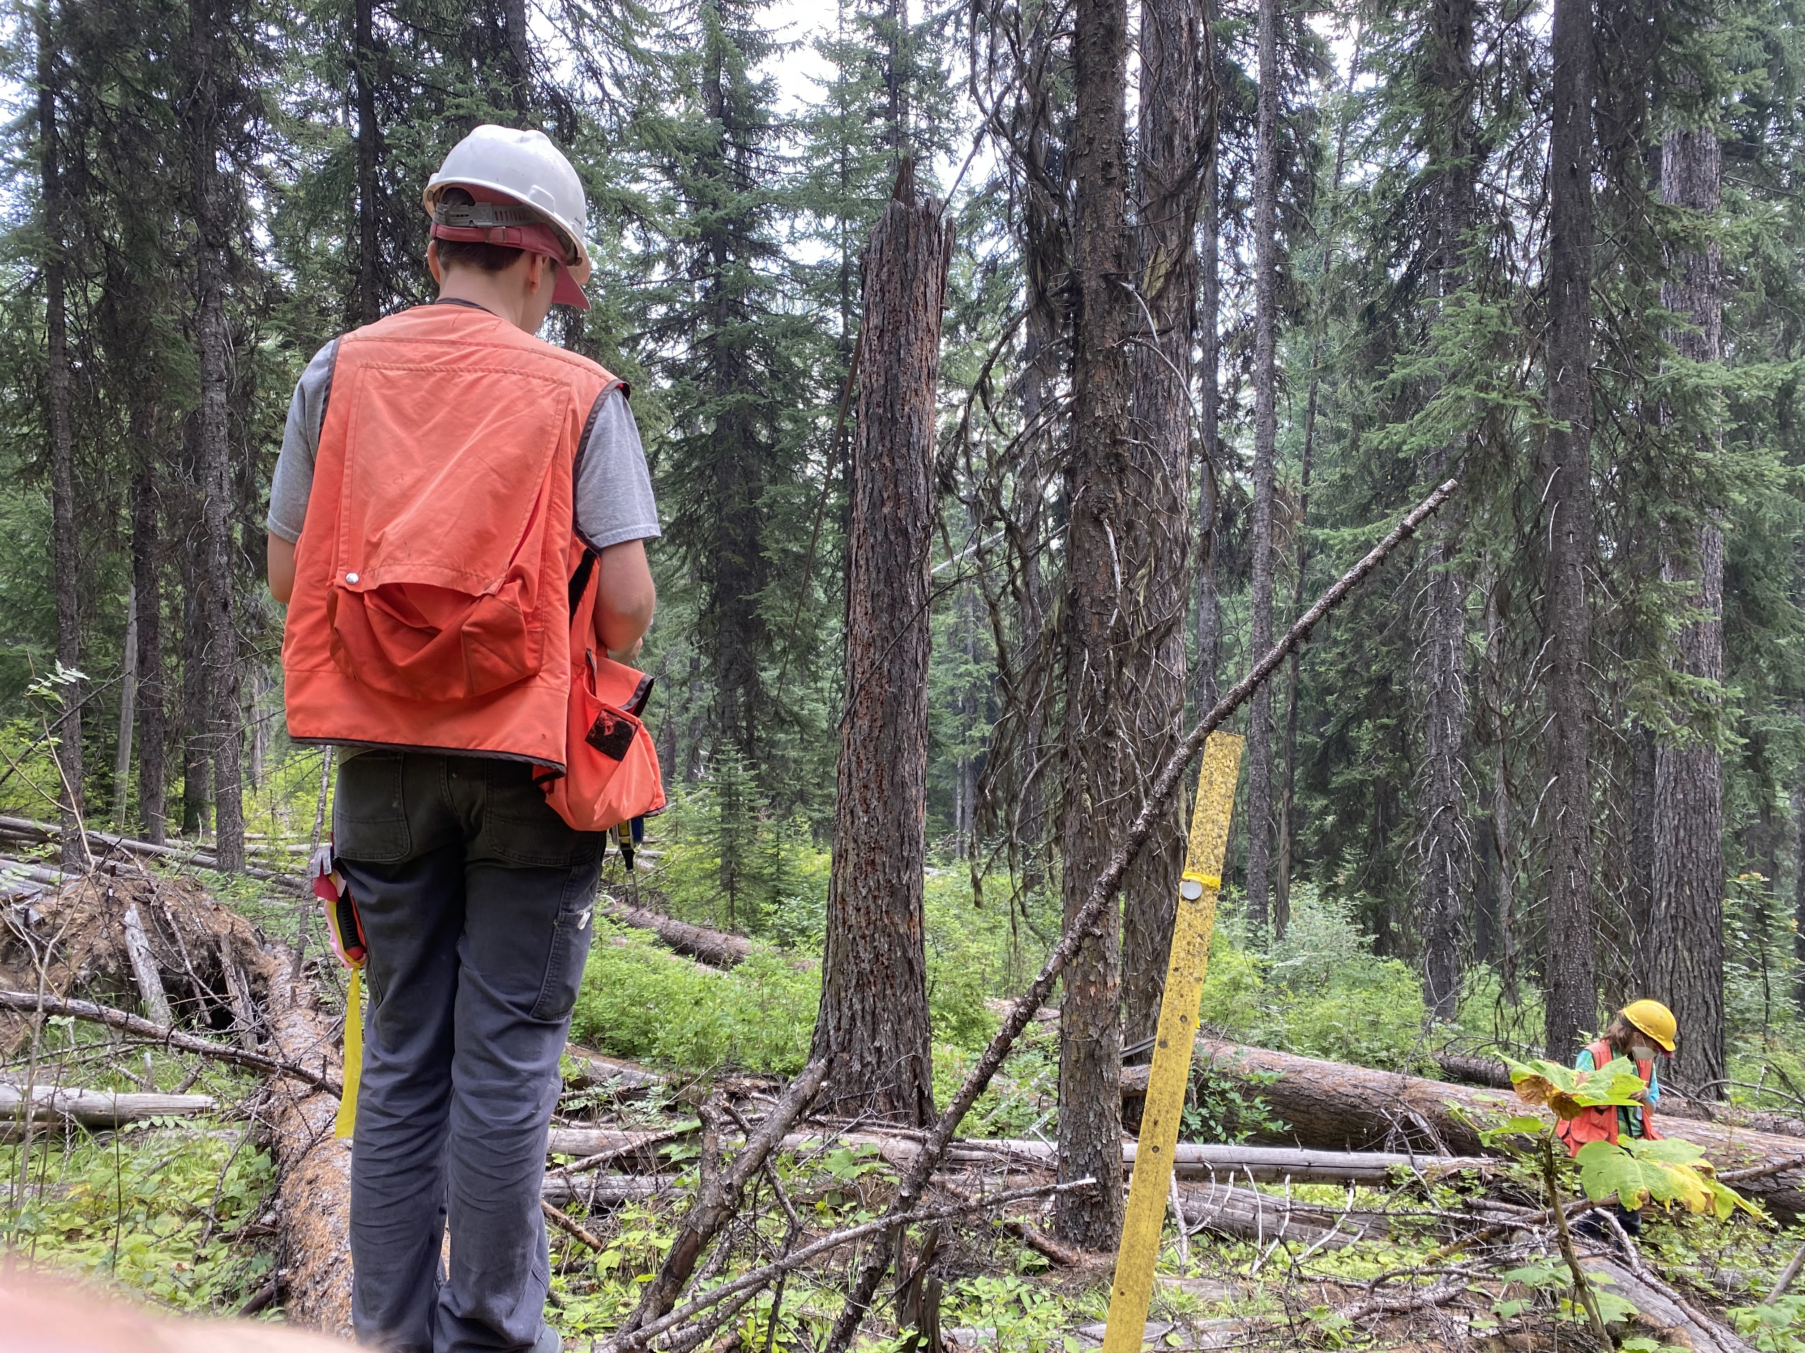
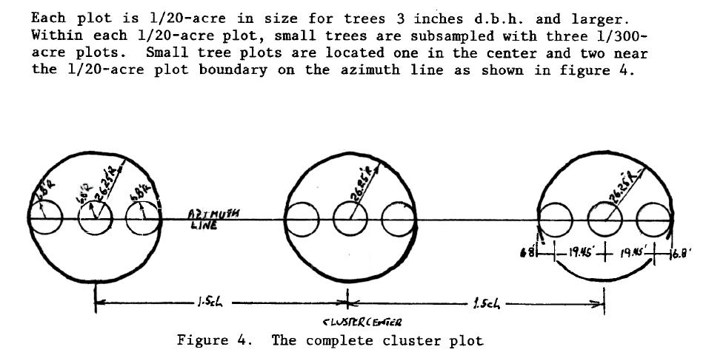
Data Collection Summer 2021
Notes:
- As established at last year’s INGY meeting, data collection this past season was focused on ‘larch-leading’ stands that were measured the most times (3-4 times).
We identified various candidate stands which fell into those criteria across the Lolo, Kootenai, Idaho panhandle, St. Joe, nez-perce-clearwater national forests.
Dave and I ended up electing to focus our work on the Lolo and Kootenai national forests in 2021. The map displays locations of those stands, as well as stands measured during the 2018 field season (7 stands on the lolo).
We hired a field crew of 3 excellent research technicians, who helped us complete re-measurements on 13 stands across the lolo and kootenai NFs.
Despite many days and nights spent in the woods without cell service, I’m proud to say that there were not any major accidents/incidents, 0 bear encounters, and 1 exciting moose encounter.
And before I talk about the data that we collected, I just want to briefly go over what the sample-design looks like because it can be a bit confusing
So first, each stand in the pgp program contains 4 plot-clusters. 3 of which were thinned – aka treatment plots, and 1 un-thinned control plot.
Each cluster contains 3- 1/20th acre plots – this is where the data for larger trees is collected
The photo on the right shows one of the crew members near a yellow stake.. The yellow stake signifies a plot center. Large trees that fall within a fixed-radius of that plot center will have their data collected
The diagram here helps visualize this.
So for each cluster, there are 3 plot-centers, all in a line on an azimuth.
Further, small tree data is collected in 300th acre micro-plots’, each large plot containing 3 microplots.
The small circles in each larger circle in the diagram represent the microplots.
So to straighten out that hierarchy – we collected data in stands
Each stand contains 4 plot clusters
Each cluster contains 3 plots where we collect data on large trees
Each plot contains 3 microplots – where we collect data on small trees

Slide 3
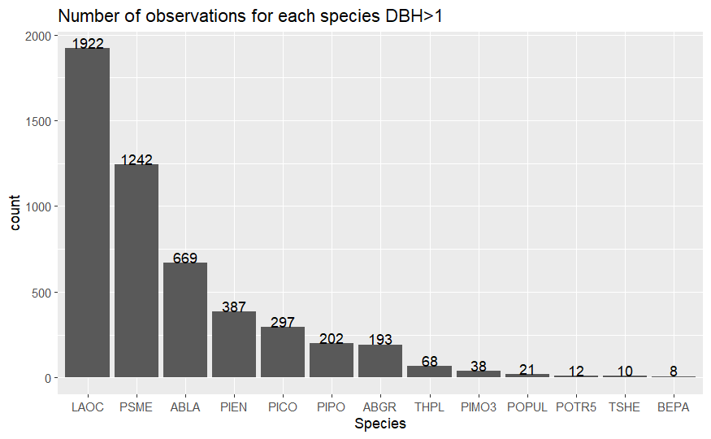
Data Collected
Notes:
So let’s talk about the data we collected last summer
Here is a graph showing how many trees of various species that we collected data on.
Species are coded in relation to their scientific name.
So, you can see that our focus on collecting data on larch was successful – we collected data on almost 2000 larch with a dbh > 1”
1200 doug fir
So on and so forth

Slide 4
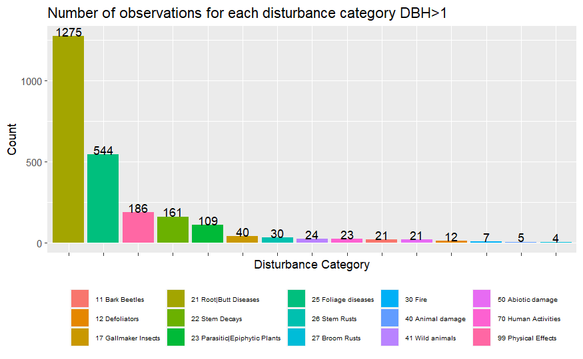
Data Collected
Notes:
These are number of trees in each disturbance category – This is not all of them, but gives you a good idea of types of damages we saw out there
Root diseases were abundant and identified in most stands
Lots of foliage diseases observed – hypodermella, lophodermella
Physicial damages
Plenty others

Slide 5
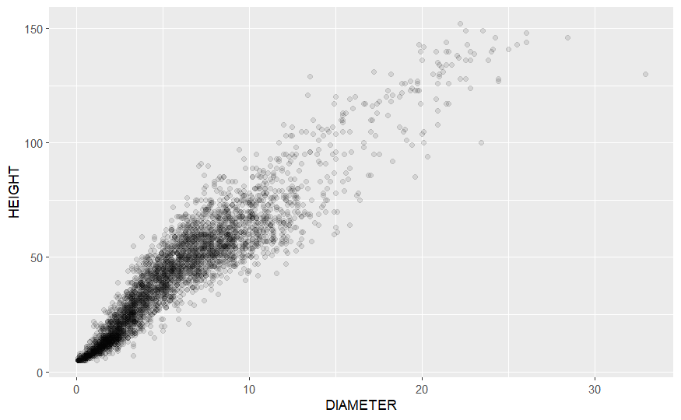
Data Collected
Notes:
Here is height vs. diameter plotted
As you can see, there’s a wide range of data that we collected here
Lots of data taken from 0 to 10 DBH, and 0 to 75 feet height

Slide 6
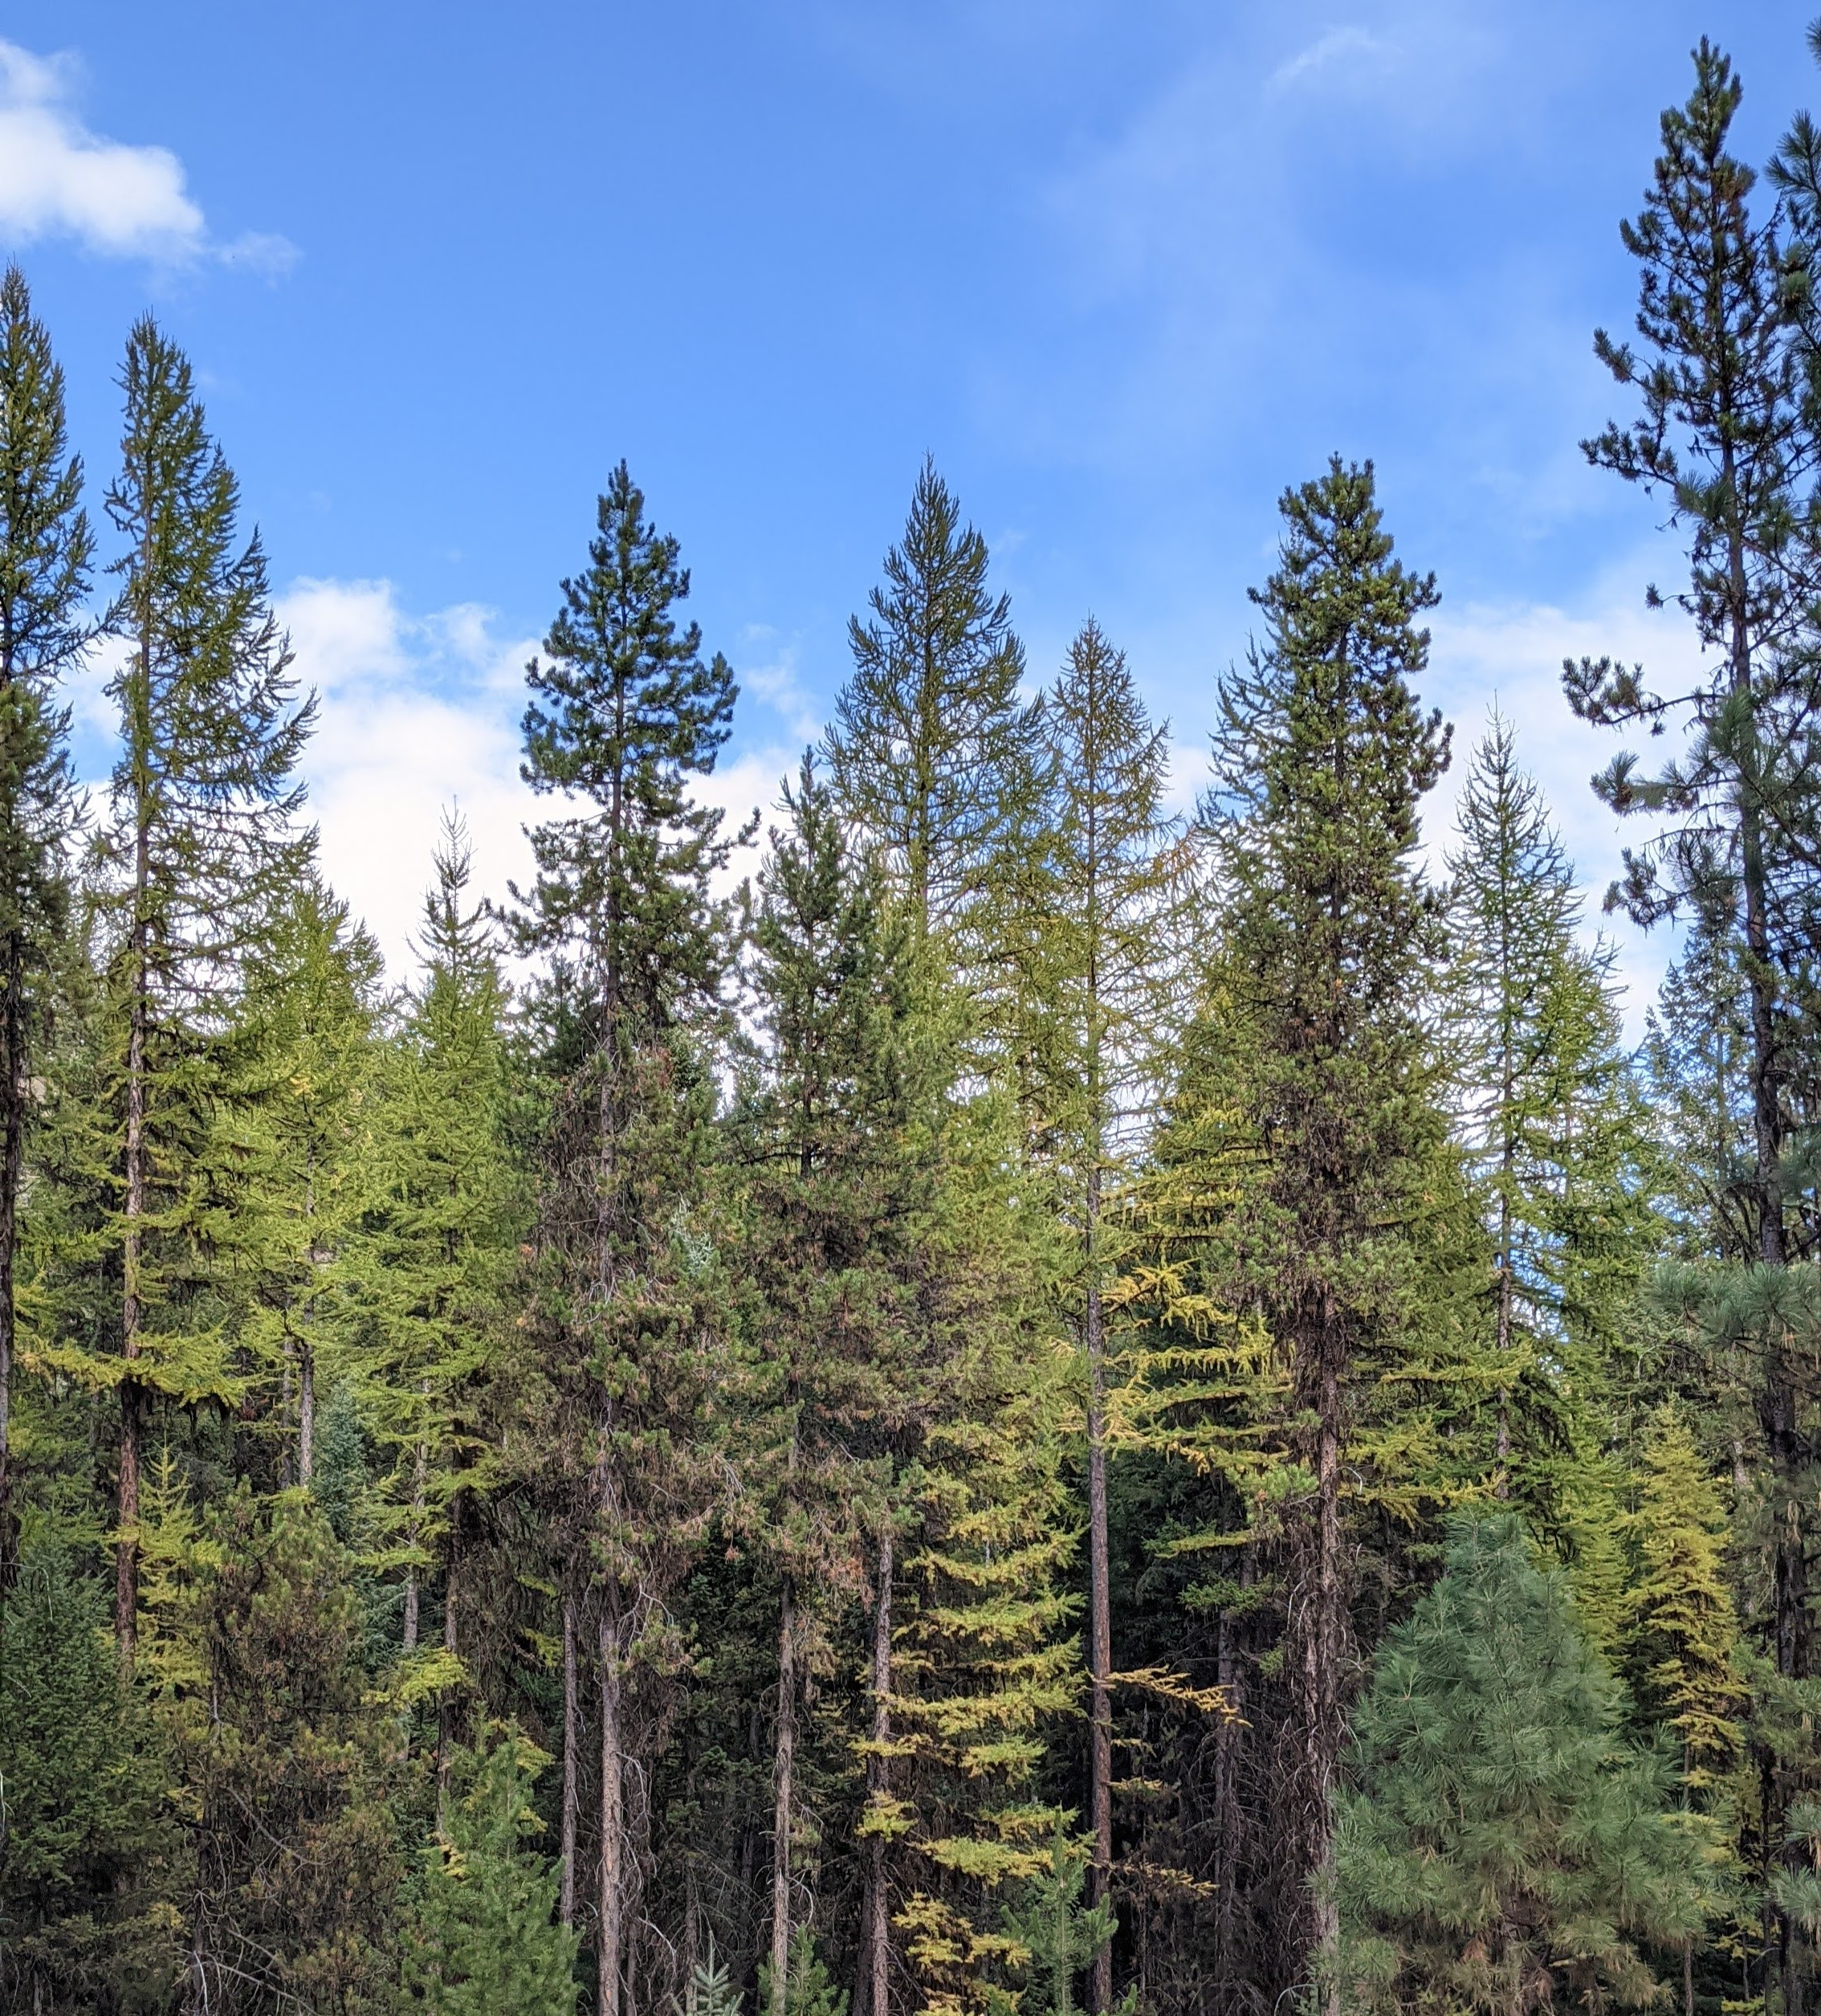
Research - Background
Focused on Western larch growth
W. larch grows across gradient: pure larch - mixed species stands
Growth dynamics are impacted by community composition
Few studies in North America
See Maguire & Mainwaring (2021)
Models don’t address spp.-mixing
Research Question:
How does stand species-composition impact basal area increment (BAI) of western larch?
Notes:
Since our data collection focused on western larch stands, and western larch is a regionally important tree species, my research is focused on (you guessed it) western larch
Specially, I’m focused on studying the growth dynamics of western larch, addressing how western larch growth is impacted by stand community species composition – also known as species-mixing
As you may know, western larch grows across a gradient of species-mixtures. From pure stands, all the way to being a minor component in diverse, species-rich stands.
Various studies out of Europe have shown that species-mixing can alter community dynamics – and I’ll have a bit more on this in the next slides
But few studies have looked these dynamics in north American forests
One study, which was based in Oregon – east of the cascades, by Maguire and Mainwaring, was published in 2021 in Forest ecology and management.
They studied species mixing effects between ponderosa, lodgepole, and grand fir on two different sites in Oregon.
They observed that in denser stands a species mixing effect seemed to be increasing stand volume – but marginal, less significant effects elsewhere.
Overall, they determined that the timing and degree of mixing effects depended strongly on initial spacings.
However, they were limited by the size of their sample and only had two separate study sites and note these as limitations in their work.
Various models describe how interior western species, including larch, grow, but no model explicitly addresses a potential species-mixing effect.
Now, of course, models like the ones that drive FVS address tree growth under a variety of stand conditions,, and of course are more generally suited to estimate tree growth. But, they do currently lack some amount of capacity to account for species-mixing effects, if they do indeed exist.
That all being said, my primary research question is: How does stand species-composition impact basal area increment of western larch?

Slide 7
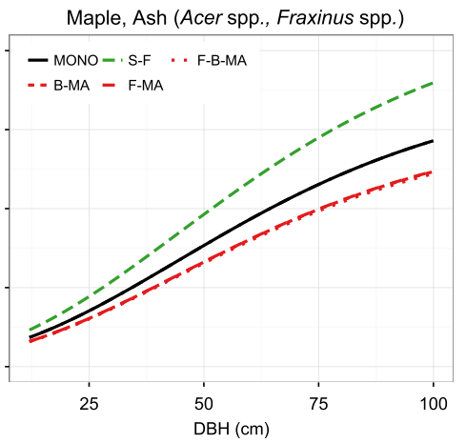
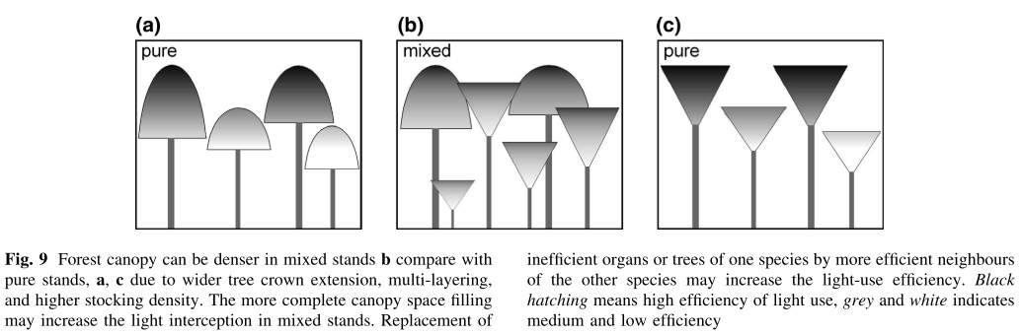
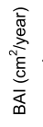
Species-mixing
Figure 9 – Pretzsch et al. (2015), European Journal of Forest Research
Figure 2 , panel 4 - Mina et al. (2018), Journal of Ecology
Species-mixing impacts vary
Hypothesis: inter-specific attribute complementarity
Notes:
So before we dive into my methods, I wanted to provide a couple of examples from the literature in species mixing to help illustrate some possible species-mixing effects.
The left figure is from Multiple factors modulate tree growth complementarity in Central European mixed forests by Marco Mina et al. 2018
This figure shows BAI-Diameter relationships for maple and ash, but across different types of species-mixtures.
The black lines represent that species growth in a mono-specific stand, where mixing attributes are non-existent, and each other line represents that species growth when mixed with other species.
So that green line above the black line, shows this relationship when maple or ash are mixed with spruce and fir, where the BAI is improved, and the red line below is bai vs. diameter of maple and ash in a fir-beech-maple mixture, where the BAI is shown to be lower.
So species-mixing can have varying effects, depending on which species are present in a mixture.
This study was specifically aimed at addressing complementarity – which they found varies across different species, across types of mixtures
On the right, is a figure extracted from Growth and yield of mixed versus pure stands of Scots pine (Pinus sylvestris L.) and European beech (Fagus sylvatica L.) analysed along a productivity gradient through Europe – by Hans Pretzsch et al. 2015. Hans Pretzsch is a prominent publisher of species-mixing work out of Europe. He co-authored this book – mixed species forests
The figure here illustrates one of the fundamental explanations offered by these types of work: Varying species attributes can relate to density and competition, and in turn, help explain why observed stand/tree growth varies between mixtures and mono-specific stands.
Essentially, the idea is that in mixed species stands, overall light interception – and therefore photosynthetic capacity - can be more efficient and generally higher, under the right conditions.
This is the hypothesis that im working with – that mixing species attributes may lead to modified community dynamics, which can alter tree growth

Slide 8
Methods: BAI GAM
Modeling BAI to determine if/how species-mix alters growth
Using Generalized Additive Modeling (GAM)
Using RMSE for model selection
Construct base-model in iterations: variable group-by-variable group
Size, Site, Density & Competition (tree-variables, plot variables)
$$ln⁡(BAI)=f_{1}\left(Size\right)+f_{2}\left(Site\right)+f_{3}\left(Competition\right)+f_{4}(Species−Mixing)$$
Base model
Notes:
To test if species-mixing impacts larch growth, I’m performing a model-driven analysis using Generalized Additive Models (or GAMs), where I use the PGP data to estimate basal area increment of larch and evaluate the effects of different predictors.
I’m using GAMs because they allow for flexibility in the model fitting process by representing non-linear relationships with smooth functions, allow the data to determine the shape of the functional relationship, and they lack the assumption/structure that traditional linear modeling approaches require.
This approach is more or less inspired by a combination of the works of Vospernik 2020, Wykoff 1990, and Monserud & Sterba 1996
Since the PGP data contain lots of variables that have already been used to estimate BAI, such as in the diameter increment model applied by FVS, it’s important that I make use of variables that we already know account for variability in BAI.
To do that, I’m setting up a base-model with such variables, so that I can have a foundation upon which I can apply a variable that represents a species-mixing effect
I’m doing this in an iterative manner, where I’ve grouped variables together by similarity, and then use RMSE and other metrics to compare models with one another
For example, variables that account for tree size are grouped, variables describing site conditions are grouped together, and variables describing competition and density are grouped together
Anyways, If you didn’t follow that, don’t worry - I’ll give more details of this model selection process in the following slides
Nope
I’m using RMSE because 1. it measures model accuracy in the same units described – so everything I compare will be compared in square inches or square cm’s per year (which is what BAI is measured in). And 2. because it can be used to penalize a model by accounting for it’s complexity, which is important since I’m dealing with more than a few predictor variables. Further, I can also use RMSE as a measure of model accuracy when I validate my model with an indepent-withheld data set, and be able to compare the error there, relative to the RMSE I saw during the fitting process.

Slide 9
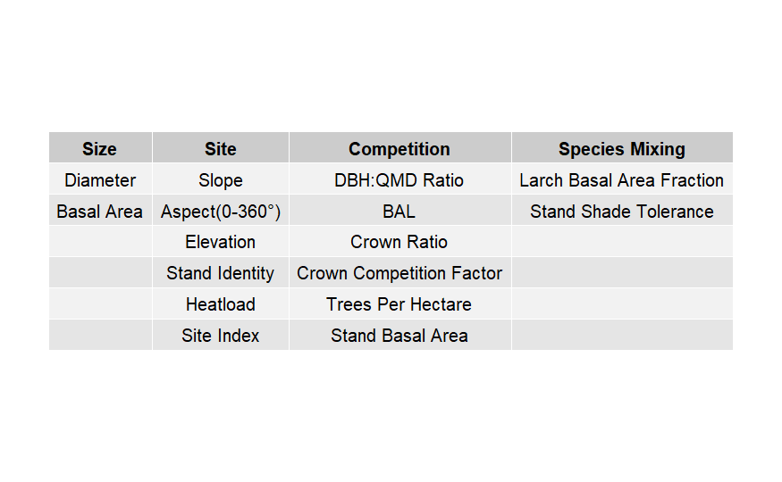
Base model selection
$$ln⁡(bai)=f_{1}\left(Size\right)+f_{2}\left(Site\right)+f_{3}\left(Competition\right)+f_{4}\left(SpeciesMixing\right)$$
Notes:
First, I start by comparing and adding size variables: Since BA and Diameter are very closely related, I only chose 1 of them. I’ll note that basal are is individual tree basal area

Slide 10
Base model selection
$$ln⁡(bai)=f_{1}\left(Size\right)+f_{2}\left(Site\right)+f_{3}\left(Competition\right)+f_{4}\left(SpeciesMixing\right)$$
Evaluated together
Each evaluated exclusive of every other
Notes:
Second, I compared and added site-related variables.
Here I compared raw topographic variables (or their respective applicable forms), Stand identity (accounting for stand effects without explicitly quantifying variables), a heatload variable which is derived from slope, aspect, and elevation, and site index (calculated for each cluster).

Slide 11
Base model selection
$$ln⁡(bai)=f_{1}\left(Size\right)+f_{2}\left(Site\right)+f_{3}\left(Competition\right)+f_{4}\left(SpeciesMixing\right)$$
Individual tree variables
Plot-level variables
Notes:
Lastly, I evaluated competition variables in their subgroups – individual tree variables, as well as plot-level variables
This is actually where I’m at in this process. I’ll share some of my progress in a minute.

Slide 12
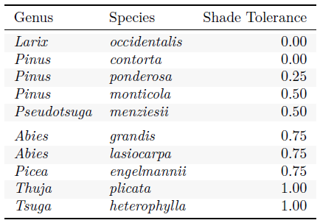
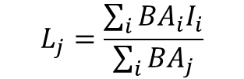
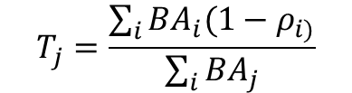
Quantifying species composition
Relative abundance of Larch
Sum of larch basal area / total basal area
Shade Tolerance weighted abundance
Sum of basal area weighted by shade tolerance / total basal area
$$L_{j}=\frac{\sum_{i}{{BA}_{i}I_{i}}}{\sum_{i}{{BA}_{j}}}$$
$$T_{j}=\frac{\sum_{i}{{BA}_{i}{(1−ρ}_{i)}}}{\sum_{i}{{BA}_{j}}}$$
Shade tolerance (Liendard et al. 2015)
Notes:
Before we look at the addition of species mixing variables, however, I should share with you how species-mixing is measured..
The first option that I’m considering is relatively simple: a ratio of the basal area of larch trees to all trees within a cluster. That is, a relative abundance of larch. If this number is high (between 0 and 1), then that means there is not much mixing of attributes. This parallels methodology used in other studies.
The second method I’m looking at is the relative abundance of species by basal area, but weighted by a species’ shade tolerance. This one definitely gets after my hypotheses a bit more. The species-specific shade tolerance is derived from Lienard’s (2015) Shade tolerance index, which identified the shade tolerance of most north American species. In this case, then, the metric is weighted by the relative shade tolerance of the plot, however, I’m using 1-the shade tolerance index of a tree so that the metric is between 0 and 1, making it similar to the relative abundance of larch above. So if the number is high (again, between 0 and 1), then the relative abundance of shade in-tolerant species is high. If the number is low, then the relative abundance of shade tolerant species is higher.
On the right are the shade tolerance values of each species.

Slide 13
The model
$$ln⁡(bai)=f_{1}\left(Size\right)+f_{2}\left(Site\right)+f_{3}\left(Competition\right)+f_{4}\left(SpeciesMixing\right)$$
Notes:
So, after selecting a solid base-model, then I add and compare the species-mix variables and see if and how they change the predictive accuracy.
One important caveat, is that there is nesting in the data structure that I have not accounted for. For example:
Individual trees are repeatedly measured over time – so there might be an effect at the individual tree level that we have not
There also may be a similar effect at the plot level.
The solution then, is to account for these effects with random effects variables through a mixed-modelling approach.
The next stage in my modeling strategy is to introduce random effects into the model at the tree and plot-levels.
But first, I’m working through the overall selection process without random effects
I haven’t gotten there yet, but here are some of my results thus far.

Slide 14
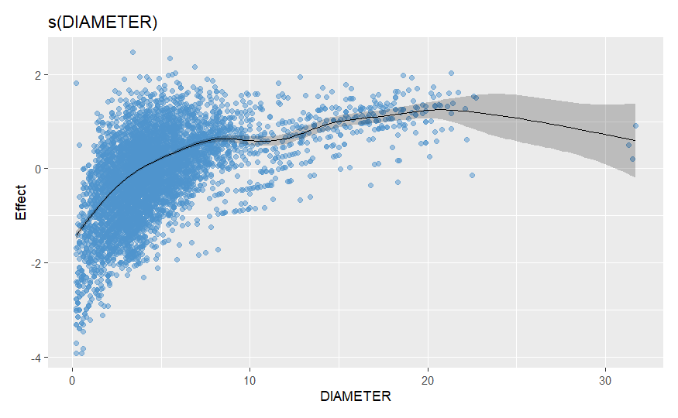
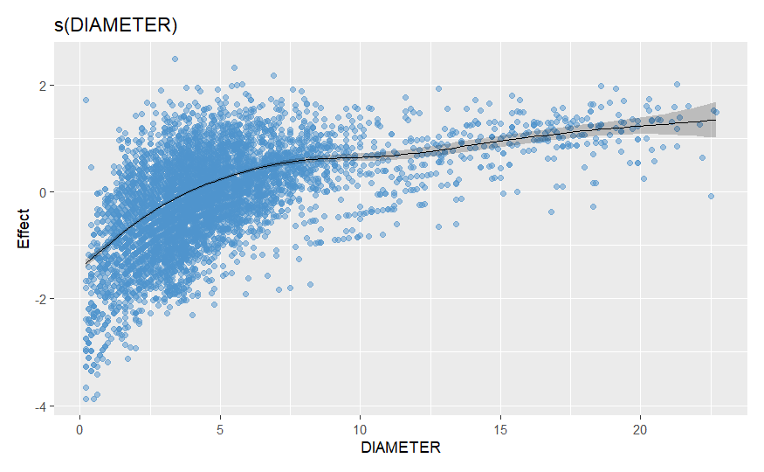
Results
Selected diameter over individual tree basal area
$$ln⁡(bai)=s(Diameter)+f_{2}\left(Site\right)+f_{3}\left(Competition\right)+f_{4}\left(SpeciesMixing\right)$$
Notes:
So for size variables, diameter proved to be the best predictor of BAI when compared with tree basal area. The resulting partial response curve is shown here.
The partial response shows diameter, and it’s relative effect on log-bai
You can see that there are 3 high diameter points pulling the smooth curve down
These points are 1 very large tree, at three points in time.
These are outliers with high-leverage on the smooth.
Since it deviates from the overall trend, I took a step back and looked at the relationship when the model was fit without these points.

Slide 15
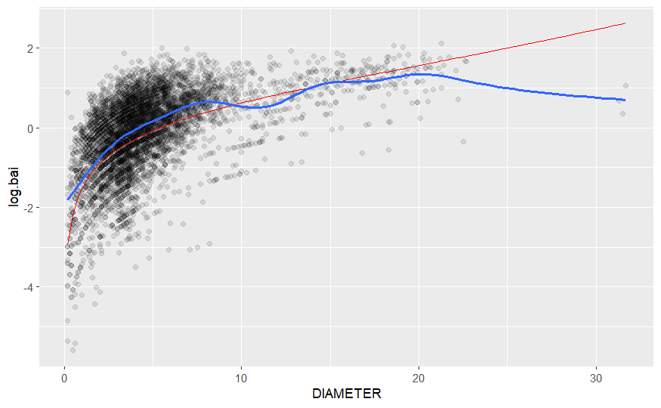
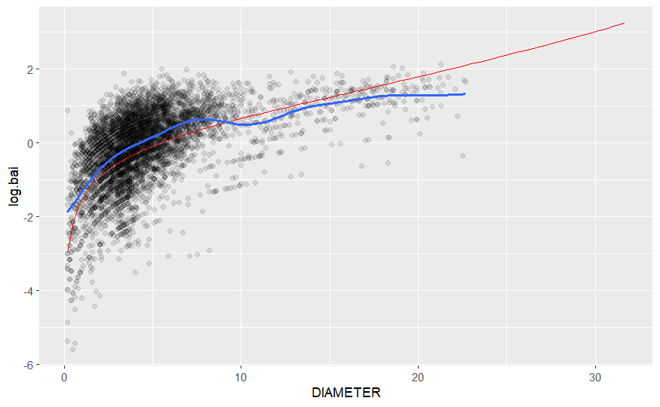
Results
Comparing this relationship with FVS
Notes:
An additional layer here is that I’m comparing these relationships with a parallel model based on the FVS model structure
Here the blue lines are the GAM smooth, and the red line is the FVS model
As you can see, the GAM definitely captures more non-linearity.
Model fit was better with the GAM as well.
I am hesitant to show more results, as I’ve run into a few issues in the modeling process
I hope these examples have given you a good idea of what I’m up to.

Slide 16
Moving forward
I still have plenty of analysis to work through
Aiming at finishing by early September – I’ll be working through the summer
Likely helping with field work this summer

